Slide 1


MINI-SOC PROJECT
https://github.com/Eng-Ahmed-Emad/A_mini_SOC-Project

Slide 2



Project Overview
This project proposes the development of a mini Security Operations Center (SOC) that combines three powerful tools:
Wazuh SIEM for centralized log collection, analysis, and alerting.
Atomic Red Team for simulating adversary techniques aligned with the MITRE ATTACK framework.
VirusTotal API integration for automated detection and verification of malicious files on Linux systems.
By integrating these technologies, the project replicates a realistic SOC workflow — from log ingestion and correlation, to adversary emulation, to automated threat intelligence validation.
02

Slide 3

Deploy a Wazuh-based SIEM to collect and analyze security events from Linux hosts.
Simulate common adversary techniques (e.g., brute force, privilege escalation, malware execution) using Atomic Red Team.
Integrate VirusTotal API for automated file hash submission and malicious file detection.
Generate real-time alerts and incident triage reports mapped to the MITRE ATT&CK framework.
Document the SOC architecture, detection use cases, and incident workflows.
Objectives
03

Slide 4




OUR TEAM
DOHA MOHAMED
POULA YOUSSEF
AHMED EMAD
EBTIHAL RAGAB
MENNA MOHAMED
04

Slide 5
Why wazuh?
Use cases
Endpoint security | Threat intelligence | Security operations | Cloud security
Configuration assessment | Threat hunting | Incident response | Container security
Malware detection | Log data analysis | Regulatory compliance | Posture management
File integrity monitoring | Vulnerability detection | IT hygiene | Workload protection
05

Slide 6
STEPS
Install Ubuntu Server (VM) – Create a dedicated virtual machine for the SOC manager.
Update System Packages – Run updates to ensure stability and security.
Install Wazuh Manager – Set up the SIEM for log collection and analysis.
Install OpenSearch & Dashboard – Enable visualization and alert monitoring.
Deploy Wazuh Agent – Install agents on Windows/Linux endpoints to collect logs.
Register Agents – Connect agents to the Wazuh Manager for monitoring.
06

Slide 7
STEPS
Configure Log Sources – Collect Windows Event Logs, Sysmon, and Linux syslog.
Enable Detection Rules – Apply Wazuh’s ruleset for threat detection.
Enable File Integrity Monitoring (FIM) – Track changes in critical files/directories on Windows & Linux.
Integrate VirusTotal API – Enrich alerts with threat intelligence data.
Run Atomic Red Team Tests – Simulate real-world attack techniques.
Verify Alerts – Check if Wazuh detects and generates alerts correctly.
07

Slide 8
STEPS
Investigate & Respond – Analyze alerts, isolate systems, and take response actions.
Document Results – Summarize detection performance and lessons learned.
Create Custom Dashboards – Build tailored views for alerts, FIM, and attack simulations.
08

Slide 9

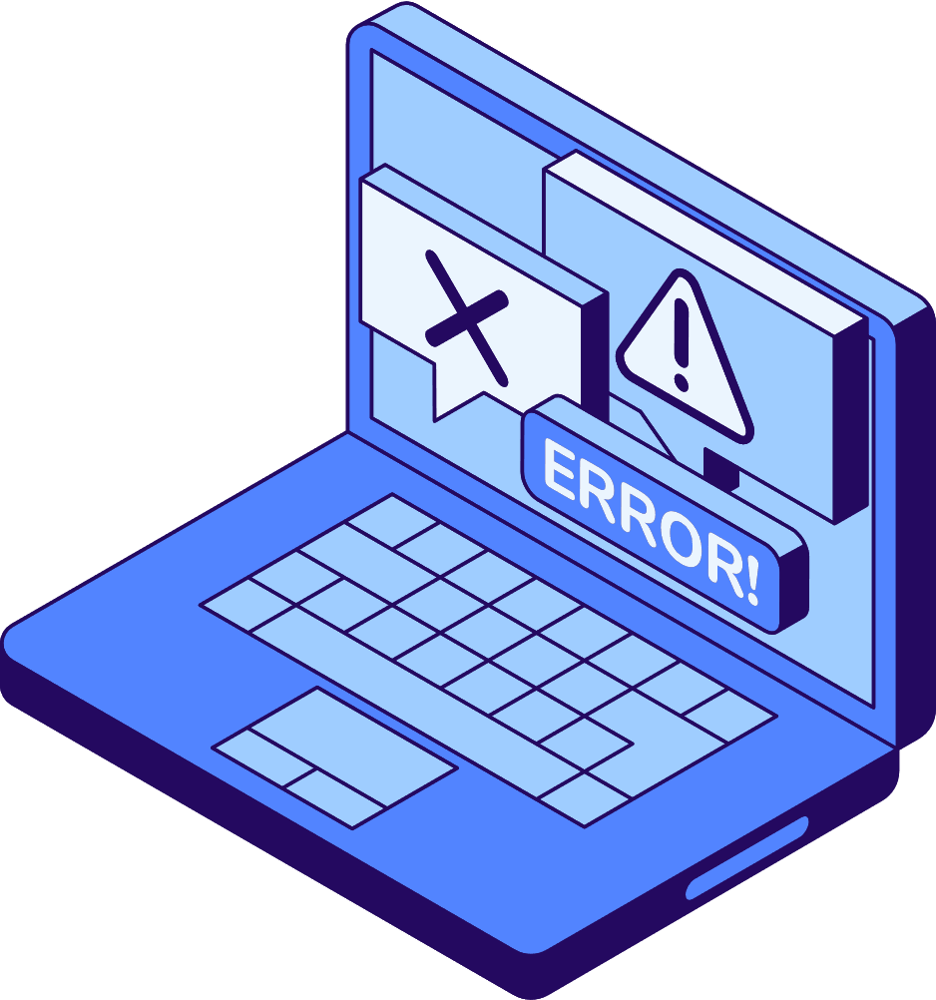
Simulated Attacks (Atomic Red Team)
🛑 Brute Force Login Attempts – repeated failed logins
🔑 Privilege Escalation – sudo abuse on Ubuntu
🐍 Malware Execution – malicious binaries & scripts
📤 Data Exfiltration – outbound suspicious traffic
🧬 Process Injection – tampering with legitimate processes
09

Slide 10

Detection Effectiveness
✅ Brute Force → alerts triggered after threshold logins
✅ Privilege Escalation → sudo misuse flagged
✅ Malware Execution → suspicious process behavior detected
✅ Data Exfiltration → flagged by outbound traffic rules
✅ Process Injection → abnormal process behavior detected
✅ VirusTotal Integration → malicious files auto-removed
10

Slide 11
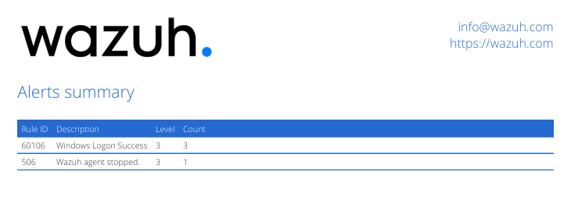
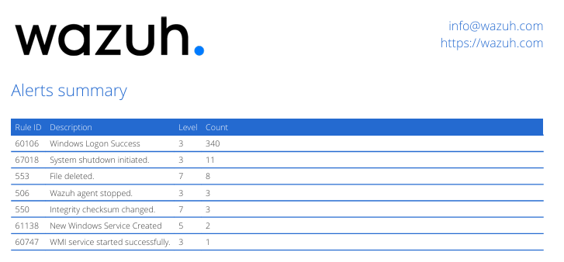
Alerts before vs after attack (Windows)
11

Slide 12
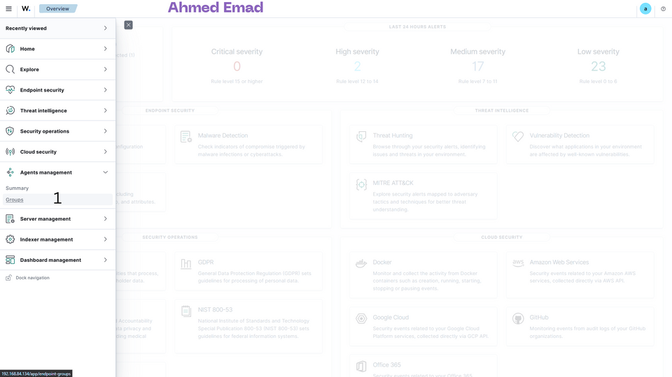
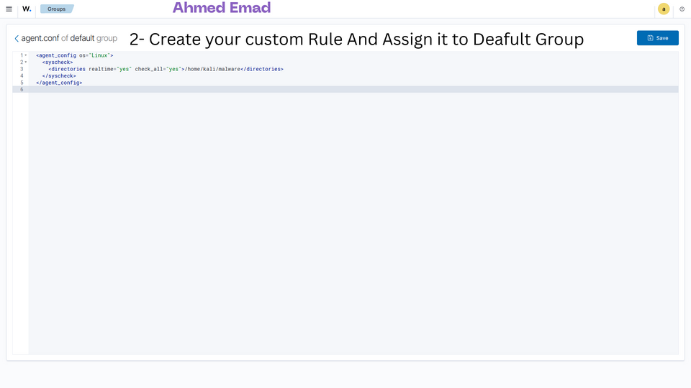
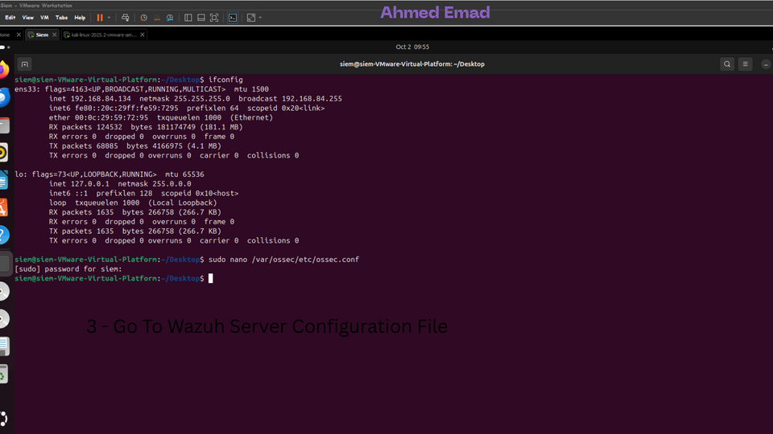
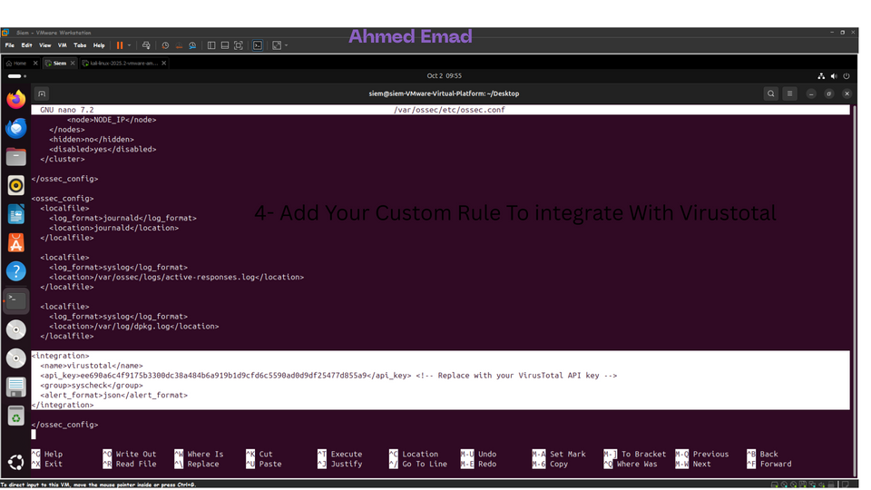
VirusTotal Integration in Mini SOC
12

Slide 13
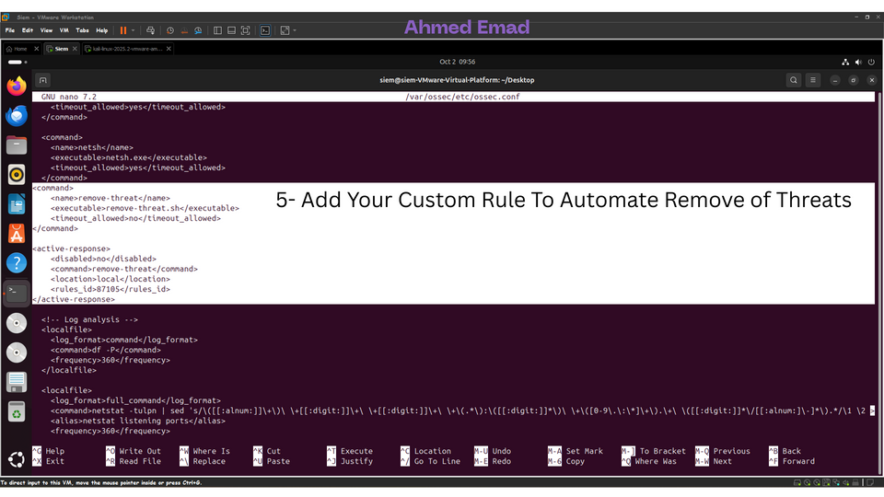
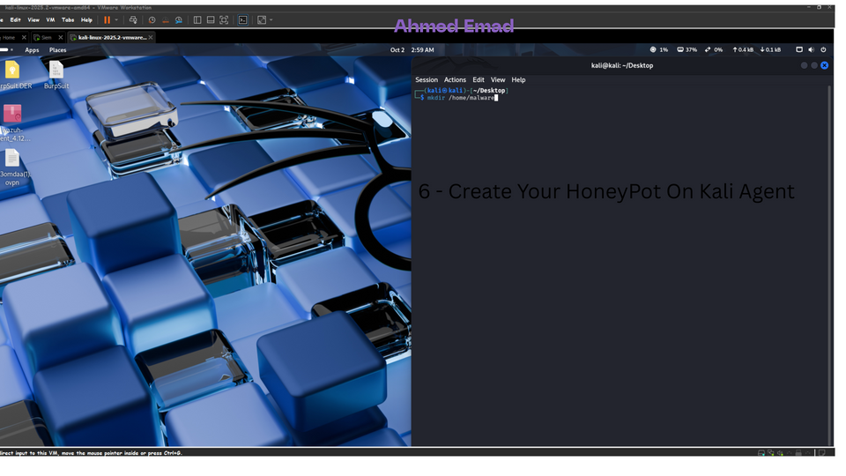
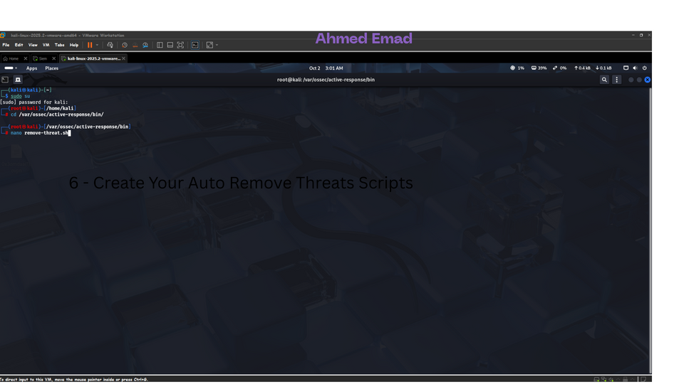
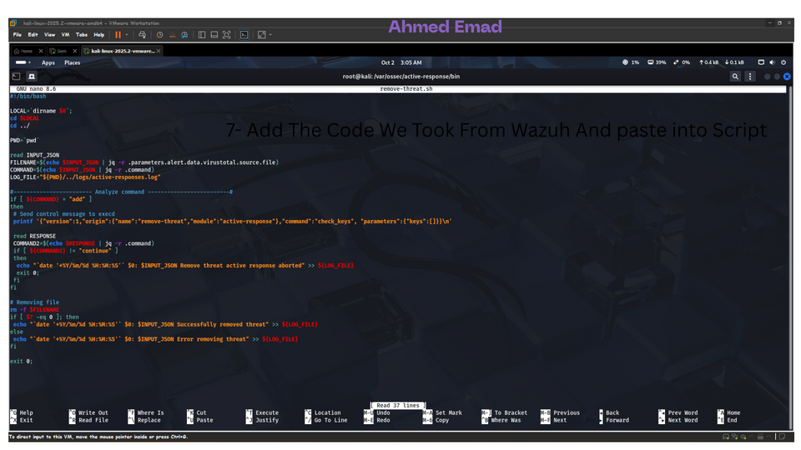
13

Slide 14
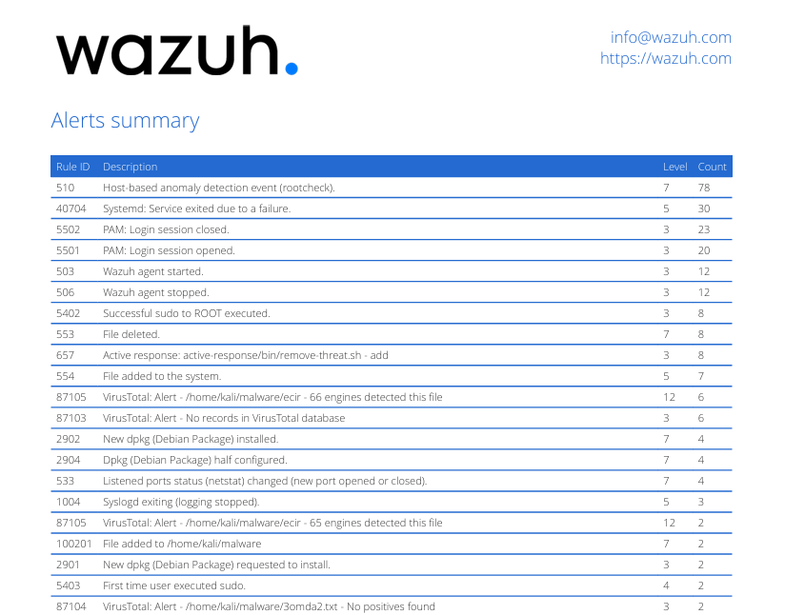
Alerts after attack (Linux+FIM+Virustotal)
11

Slide 15
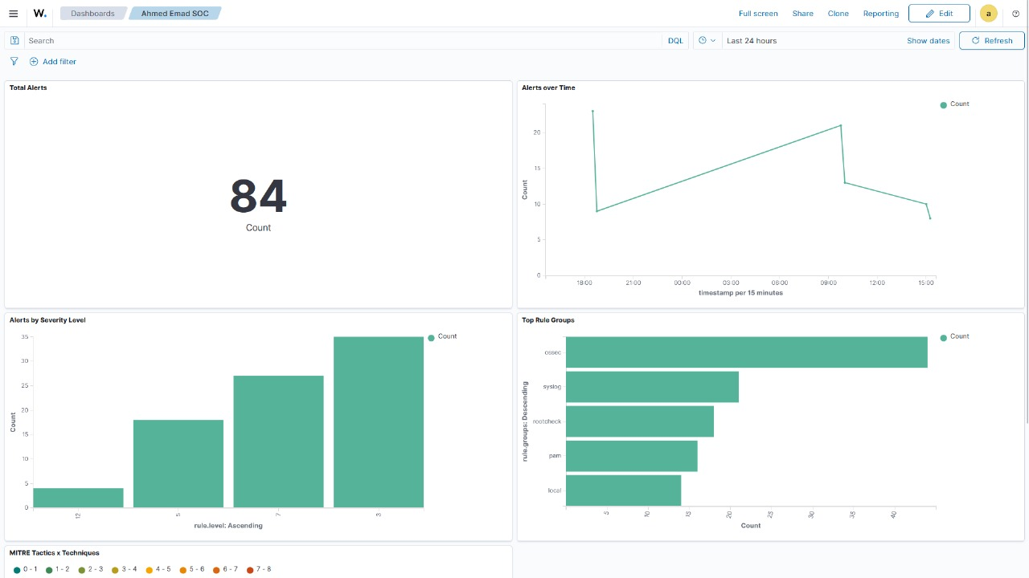
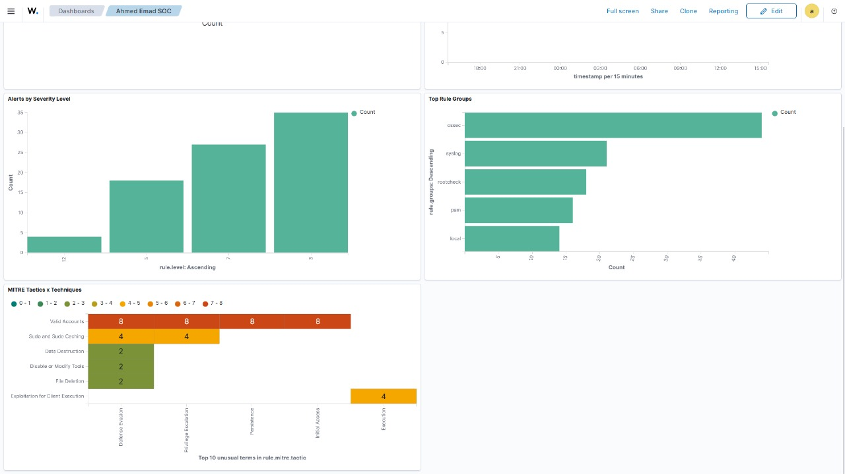
Created a custom dashboard
14

Slide 16
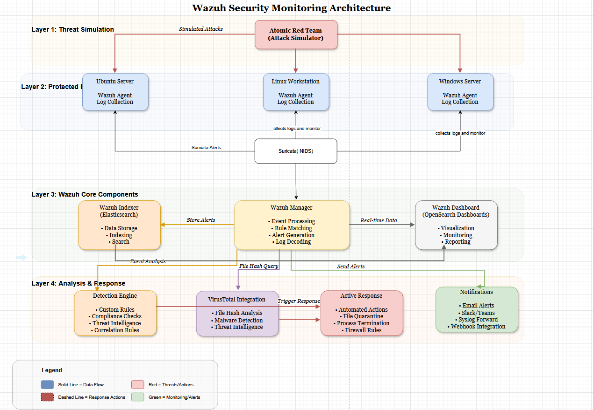
Our Architecture
16

Slide 17

RISK MANAGEMENT
Risk Assessments
Identified key risks (misconfigurations, API limits, delays) and applied mitigation strategies.
Policy Development
Access Control → Strong authentication & least privilege enforced.
Log Management → Centralized log collection in Wazuh, retained for analysis & compliance.
Incident Response → Defined thresholds, rapid triage, and automated actions (e.g., quarantine, block).
Malware Handling → Files auto-scanned with VirusTotal; malicious files quarantined/deleted.
Continuous Improvement → Regular tuning of rules, scheduled attack simulations, and policy updates.
15

Slide 18
THANK YOU FOR YOUR ATTENTION
16
https://github.com/Eng-Ahmed-Emad/A_mini_SOC-Project

